Slide 1

EMPOWERING REAL – TIME ECONOMIC DECISIONS THROUGH EDGE COMPUTING FOR MINIMAL LATENCY
Presented By:
Under esteemed guidance of:
Dr. B. RAMESH BABU
Ph.D Assist.professor
K.Santosh
(23UJ1A6676)

Slide 2
Index
Abstract
Introduction
Motivation
Problem Definition
Literature Survey
Research Gaps
Proposed Systems
Existing Methodology
Drawbacks
ProposedMethodology
Detailed Proposed Methodology
Sample Code
Packages Used
Result Analysis
Software Details
Advantages and Applications
Conclusion
Future Scope
References

Slide 3
Abstract
Edge Computing (EC) is a new technology that extends Cloud Computing (CC) services closer to data sources . In Present Generation, timely economic Decision making is important for maintaining Efficiency across sectors such as finance, Retail, Supply chain and Smart Infrastructure . This Project Explores about the Implementation of Edge Computing as a Solution to Enable Real time Economic Decisions for Minimal Latency.

Slide 4
Introduction
In Today's economic environments, real-time decision-making is essential for Making Efficient decisions.
Edge computing processes data near the source.
Edge Computing is used to minimize the data travel time and reduces the Latency.
To demonstrate how Edge computing can transform the speed and accuracy of critical Economic Decisions.

Slide 5
Motivation
In modern economies, real-time decision-making is crucial in sectors
like finance, retail, and supply chain.
Traditional cloud computing introduces latency due to centralized data processing.
High latency can lead to delayed actions, missed opportunities, and reduced efficiency.
It allows instant analysis and decisions without needing to send data to distant servers.

Slide 6
Problem Definition
The most commonly used economic decision making systems depends on centralized cloud computing to collect the process and analyse the data. The Centralized Cloud Server systems take more time to process the data and delays in decisions lead to wrong decisions. To enhance this problem Edge Computing was introduced. The Edge Computing Servers take decisions where the data is generated and modifies the data based on customers

Slide 7
Literature Survey
Author and year | Title | Existing methodology | Proposed SyStem | Key contribution | Drawbracks
Bharath Kumar Gaddam(2024) | Edge Computing in Financial Analytics | Traditional cloud computing, which relies on centralized data centers, suffers from higher latency (milliseconds to seconds) and slower response times for time-sensitive financial applications. | Edge computing architecture applied in financial services to achieve sub-millisecond latency, real-time fraud detection, high-frequency trading, and distributed risk management with edge-based decision-making. | Demonstrates latency reduction up to 80% in financial applications like high- frequency trading and fraud detection. | Data fragmentation
Tariq Al-Momani et al. (2023) | Edge AI for real-time decision-making | Centralized architectures lack flexibility to support diverse IoT service demands. | Introduces an integrated architecture combining MEC and network slicing to customize resources for IoT services. | Edge AI enhances low- latency, privacy, and bandwidth in sectors like smart cities and healthcare. | Limited Computational Resources
Haftay.G Abra (2022) | Edge AI for real-time decision-making | Centralized architectures lack flexibility to support diverse IoT service demands. | A privacy-preserving architecture enabling decentralized model training across edge devices without sharing raw data. | Supports real- time processing with privacy by avoiding raw data sharing. | Security Vulnerabilities
ShreshthTuli,S.Ilaer(2020) | Scheduling in edge-cloud using reinforcement learning | Prior models like Decima and fair scheduling either suffer from slow training, inefficient DAG processing, for dynamic workloads. | A deep reinforcement learning-based edge resource scheduler using transformers for optimized task allocation and low-latency job execution in edge cloudenvironments. | Real-time scheduler (A3C-based) to optimize latency and energy in stochastic environments. | High Training Complexity and Time

Slide 8
Research Gaps
Data fragmentation: Data gets dispersed across many edge nodes.
Limited computational resources: refer to the constrained processing power, memory, storage, and energy availability of a device or system
Security vulnerabilities: are weaknesses or flaws in a system's design, implementation, or
code that can be exploited by attackers .
High training complexity and time: refer to the significant computational effort, time, and resources required to train machine learning

Slide 9
Proposed System
In Edge Computing processing data takes place closer to the source , it makes reduction of work for the Central Servers.
With the Help of Model Pruning and Model Optimization Inference Accuracy risks can be dissolved.
Processing Data in Edge Computing takes place locally at the Edge it may reduce Data Security and Privacy Risks.
Devices like Google Coral (Edge TPU) or Nvidia Jetson have specialized hardware for running AI models with minimal power and resource consumption.

Slide 10
Existing Methodology
Edge-Based Data Collection and Preprocessing
Real-time collection of economic indicators and transactional data
Lightweight preprocessing (e.g., filtering, normalization) done locally to reduce transmission overhead.
Real-Time Decision Making Using Edge AI:
Pre-trained ML models (e.g., LSTM, CNN) deployed on edge devices
Which enables sub-second decision-making for use cases like fraud detection or dynamic pricing.

Slide 11
Drawbacks
Limited Data Processing: Edge devices may struggle to handle large,
complex data sets, especially when dealing with high-frequency
financial data.
Computational Limits: Running complex AI models on edge devices can be slow due to limited processing power.
Security Vulnerabilities: Edge devices are often physically more accessible and more vulnerable to security attacks.
Limited Model Accuracy: Federated learning can lead to suboptimal models because devices may have small, non-representative datasets.

Slide 12
Proposed Methodology
Multi-Layer Security: Implement a multi-layer security approach combining lightweight encryption, VPNs, and firewall protections at both the device and network level to protect sensitive data.
AI-Driven Intrusion Detection Systems (IDS): Integrate AI-powered IDS at the edge to continuously monitor for any unusual or malicious activity, reducing vulnerabilities.
Hybrid Edge-Cloud Preprocessing: Use cloud resources for heavy preprocessing tasks and edge devices for lightweight data filtering and normalization. This hybrid approach reduces the computational burden on edge devices and speeds up processing times.

Slide 13



DETAILED PROPOSED METHODOLOGY
CATEGORY | Algorithm | Purpose
Machine Learning (ML) | Decision Trees / Random Forests | Rule-based or ensemble decision systems
 | K-Nearest Neighbors (KNN) | Localized pattern recognition
 | Gradient Boosting (XGBoost, LightGBM, CatBoost) | High accuracy for complex decisions
 | Neural Networks (shallow) | Pattern recognition with fast inference

Slide 14
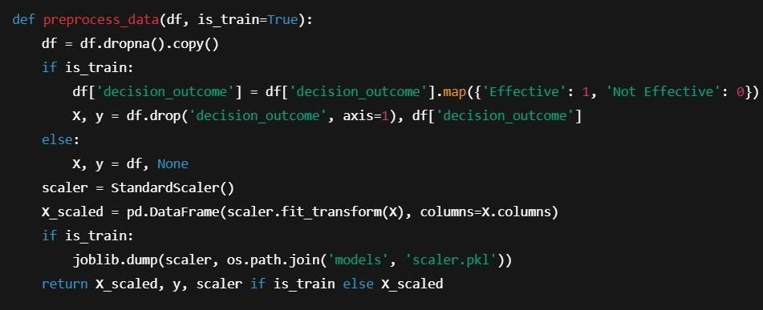
Sample Code

Slide 15
Packages used
PANDAS : Data Manipulation (cleaning , aggregating)
NUMPY : Numerical operations (e.g., CLV calculations)
SCI-KIT LEARN : Machine Learning Models (Linear Regression, Lasso, Decision Trees)
MATPLOTLIB/SEARBORN : Visualization. (CLV trends
customer segments

Slide 16
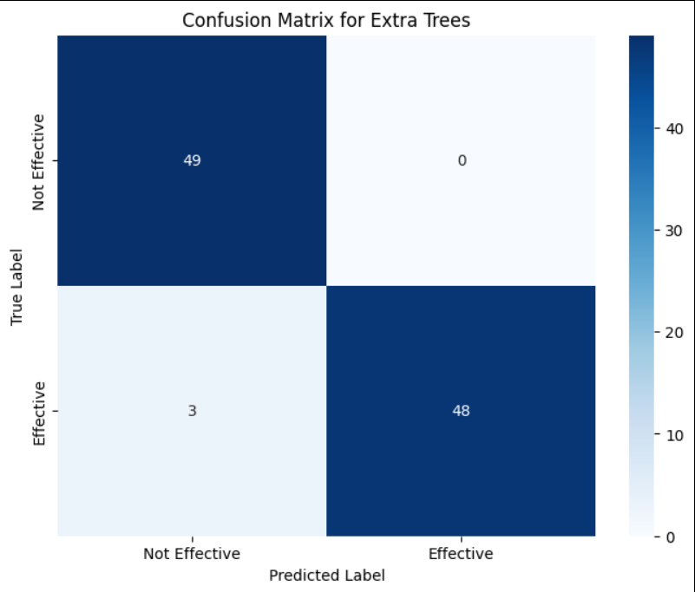
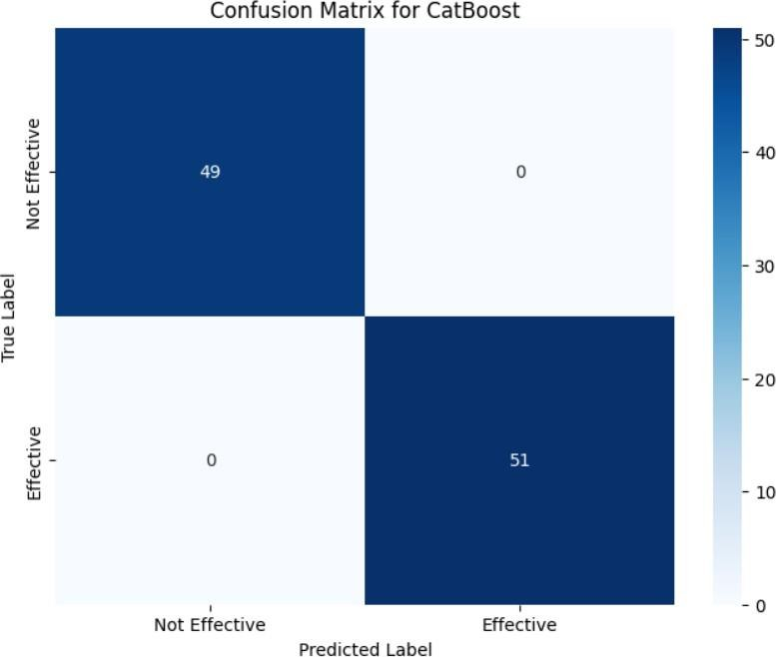
Result Analysis
Matrix for extra trees
Matrix for CatBoost

Slide 17
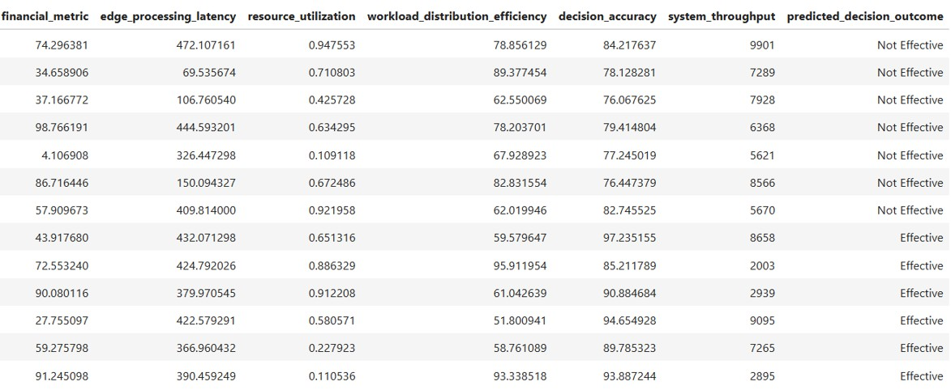
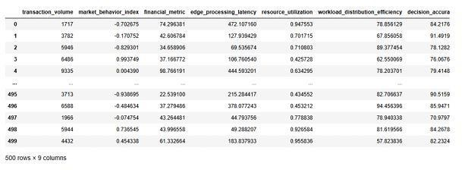

Slide 18
Software Details
Edge computing software plays a
crucial role in managing edge
computing resources, orchestrating data processing tasks, and ensuring seamless communication between edge devices and centralized systems.
Edge Software like KubeEdge, AWS IoT Greengrass, Azure IoT Edge,
Open Horizon that manages workloads and models at the edge;
supports containerized deployments.
Immediate collection and transformation of economic signals using
Apache Kafka, Apache Pulsar, Redpanda.

Slide 19
Advantages & Applications
ADVANTAGES | APPLICATIONS
Reduced latency Improves the response time Enhances security and data privacy. Managing the distributed systems. | High-Frequency Trading (HFT) Fraud Detection in Financial Transactions Dynamic Pricing in Retail and E- commerce

Slide 20
Conclusion
Using edge computing helps make economic decisions much faster by processing data close to where it’s collected, instead of sending it to the cloud. This reduces delay (latency) and allows real-time actions, like adjusting prices or managing supply quickly. The system stays accurate, works well even with weak internet, and keeps data more secure. Overall, edge computing is a smart way to make faster and better decisions in today’s fast-moving world.

Slide 21
Future Scopes
Autonomous Systems and Logistics:In sectors like transportation and logistics, edge computing will enable autonomous vehicles and drones to make split- second decisions, improving operational efficiency and reducing costs.
5G and Network Enhancements:As 5G expands, it will supercharge edge computing’s potential by enabling ultra-low latency connectivity, especially in remote and high-speed use cases.
Agricultural Economics and Smart Farming: Sensors and edge devices in agriculture will make real-time decisions about irrigation, fertilization, and harvesting.
Healthcare and Telemedicine:Hospitals can make cost-effective decisions based on real-time patient monitoring.

Slide 22
References
Bharath Kumar Gaddam(2024): Edge Computing in Financial Analytics
Tariq Al-Momani, Maysa Al-Hussein(2023):Edge AI for real-time decision-making
Haftay G. Abreha(2022): Federated learning in edge computing
Shreshth Tuli, S. Ilager(2020):Scheduling in edge-cloud using reinforcement learning
Premsankar et al.Edge computing for the Internet of Things: A case study. IEEE Internet Things J. 2018,
5, 1275–1284.
Björkdahl, J. Strategies for digitalization in manufacturing firms. Calif. Manag. Rev. 2020
Zhao, Liang, et al. Real-time Economic Forecasting Using Edge Computing. IEEE Access, 2021.
Chen, Min, et al. AI at the Edge: Real-time Decision Making for Economic Systems. IEEE Network, 2021.
Zhang, Qi, et al. Edge Computing Paradigm: State of the Art and Research Challenges. IEEE
Communications Magazine, 2017.
Xu, Zongpeng, et al. Real-time Big Data Analytics for Financial Applications. IEEE Transactions on Big Data, 2019.

Slide 23
Thank You

